Slide 1

Topic Extractor For Twitter Threads using Latent Dirichlet Allocation (LDA)

Slide 2
Introduction
Topic Models are type of statistical language models used for uncovering hidden structure in a collection of texts. They are very useful for the purpose for document clustering, organizing large blocks of textual data, information retrieval from unstructured text and feature selection. There are several existing algorithms that can be used to perform the topic modeling.
pLSA
Probabilistic Latent Semantic Analysis
LSA/LSI
LDA
Latent Semantic Analysis/Indexing
2
Latent Dirichlet Allocation
1
3

Slide 3
Why Twitter Threads Topic Extracting and LDA?
1
2
Some Twitter threads too long and take a lot time to read them.
It’s intuitive, no embedding nor hidden dimensions.
Topic Extraction
Topic extraction lists the key phrases and concepts to give the gist of an article or document.
3
4
There are threads that include things which is out of topic such as ads, clickbait and etc.
It can predict topics for new unseen documents.

Slide 4
Concept of Latent Dirichlet Allocation (LDA)
An unsupervised machine-learning model that takes documents as input and finds topics as output.
One of the most popular topic modelling method
The aim is to find topics a document belongs to, based on the words in it
Example:
Document 1: employee, wages, company, income (Topic: Business) Document 2: student, university, Degree, courses (Topic: Education)

Slide 5
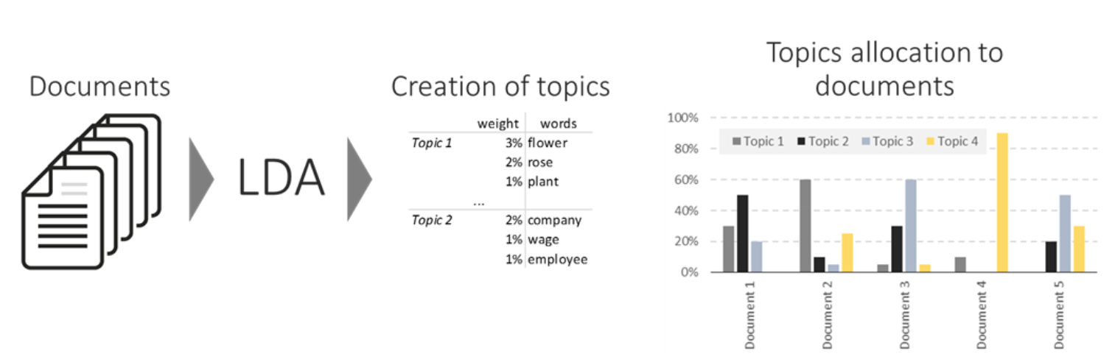
LDA Visualization

Slide 6



Topic Extractor For Twitter Threads using Latent Dirichlet Allocation (LDA)
Aim: Find the topic of twitter threads using LDA by extracting the words from twitter threads.
Training the model using news articles.
Testing using twitter threads instead of documents as input.
LDA
Stream Twitter threads
(Input)
Training: news articles
Test: twitter threads
Topic of the threads
(Output)

Slide 7
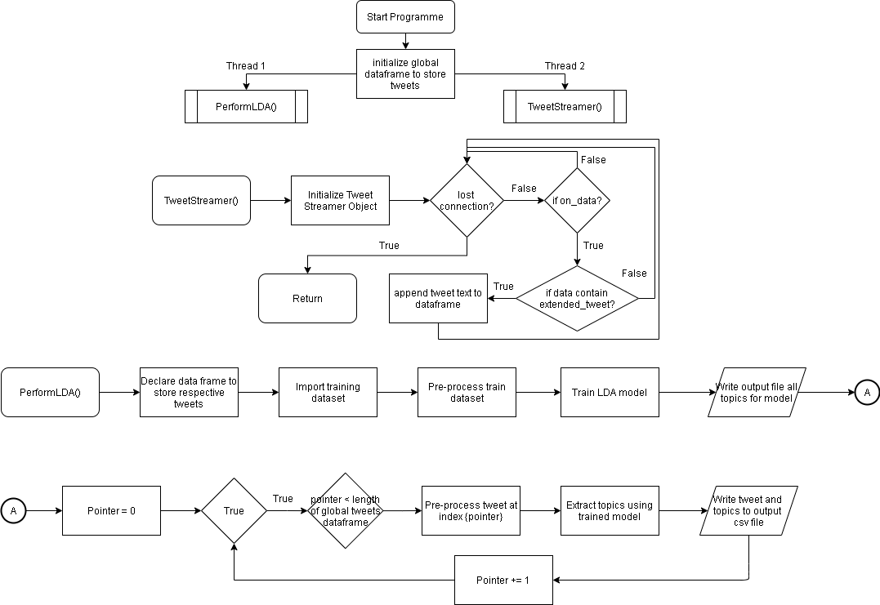
Flowchart

Slide 8
Demo
Python Code Demonstration

Slide 9
End of Slides

